Slide 1

The Globalizing K-Pop Project: Analysing Social Support in K-Pop Fandoms on Social Media Using Topic Modelling and Large Language Models
Prepared by:
Aditi, Gunpreet, Krish
Supervised By:
Dr. Stacey Scott
Dr. Ritu Chaturvedi

Slide 2
Contents
Objective
Background
Research Workflow
Methodology
Results
Evaluation and Comparative Study
Future Work
Conclusion
References

Slide 3
Objective
Social media platforms like Twitter and Reddit have become vital platforms for online discussions particularly within K-pop fandoms. This research aims to explore how these platforms have reshaped connections and bonds among people, with a focus on K-pop fandoms, which are notable for their active engagement and the personal connection fostered by idols on social media.
This research uses topic modelling and natural language processing techniques to understand emotions, opinions and social support within these fandoms [1]. LLMs are used to represent results of the topic models.

Slide 4
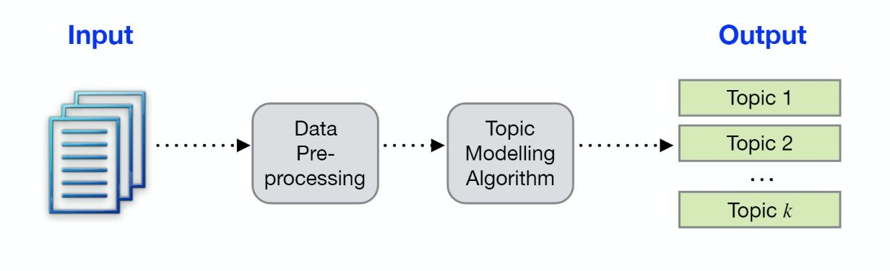
Background
K-pop is a form of popular music originating in South Korea as part of South Korean culture.
Topic Modelling is a statistical technique which is used to discover latent topics that exist within a collection of documents.
Large Language Models (LLMs): AI models trained on vast text data to understand and generate human language, used in content creation.

Slide 5
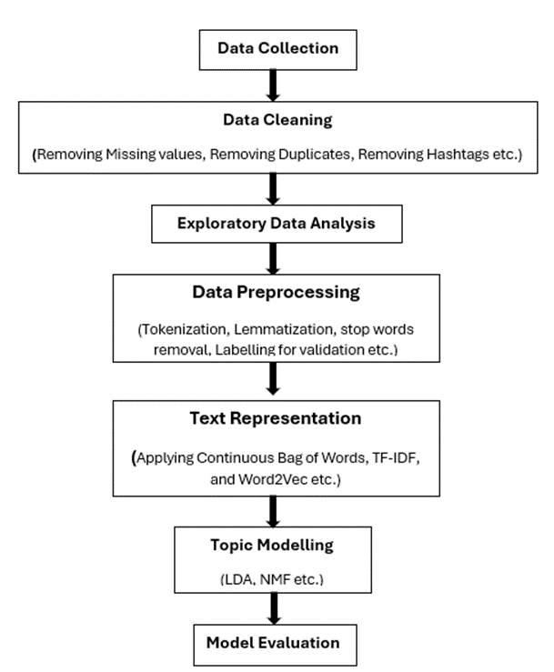
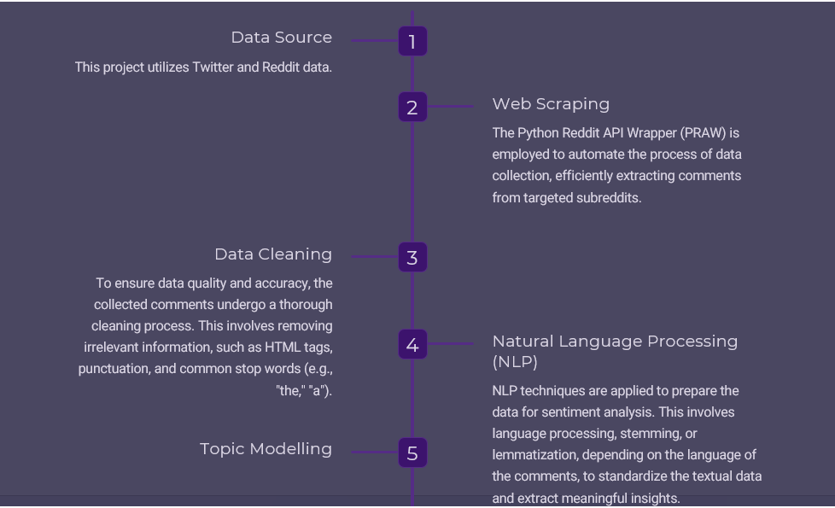
Research Workflow

Slide 6
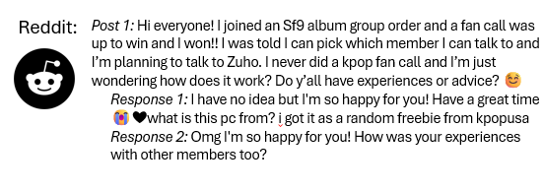
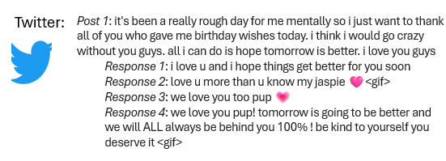
Methodology
1. Data Collection
Collected Reddit data using PRAW (web crawler)
Gathered Twitter data related to K-pop fandoms using Twitter API.

Slide 7
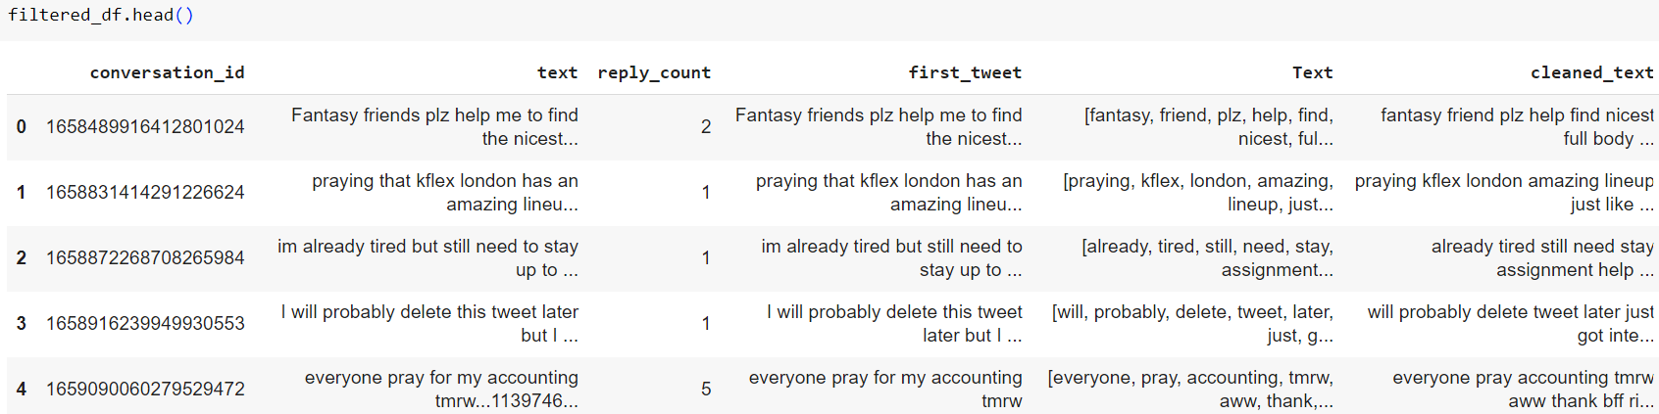
Methodology
2. Data Pre-Processing
Linked conversations using conversation IDs
Cleaned data: removed emojis, hashtags, special characters, and fandom names; translated non-English text to English
Converted text to lower case
Performed tokenization, stop word removal and lemmatization
Applied Keyword filtering
Fig.1 Preview of the Pre-Processed Dataset

Slide 8
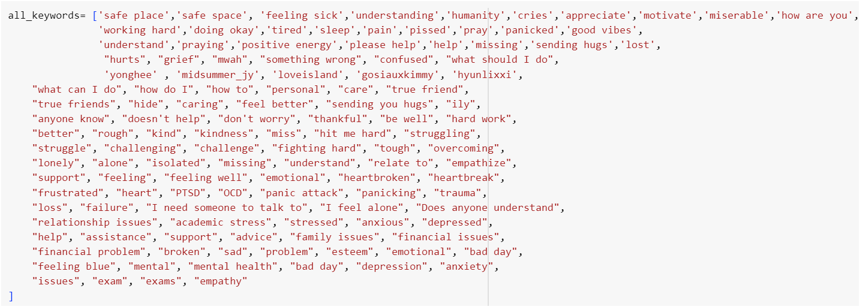
Methodology
3. Text Representation: This is used to transform raw text into numerical format for analysis.
TF-IDF:
We calculated Term Frequency-Inverse Document Frequency to weigh the importance of words. This representation was used for all four topic models: Latent Dirichlet Allocation (LDA), Non-Negative Matrix Factorization (NMF), Latent Semantic Analysis (LSA), and BERTopic.
Voyage-AI: Instruction-tuned general-purpose embedding model optimized for clustering, classification, and retrieval.
Fig.2 Keyword List Used for filtering

Slide 9
Methodology
4. Topic Modelling: Applied four topic models for extracting topics from the text data:
Latent Dirichlet Allocation (LDA): A generative statistical model used for topic modeling that discovers latent topics in a set of documents by assuming each document is a mixture of topics and each topic is a mixture of words. LDA is suitable for this case as it performs random sampling of the data, providing better text analysis. [2]
Non-Negative Matrix Factorization (NMF): A matrix factorization method that decomposes a document-term matrix into two lower-dimensional non-negative matrices to identify latent topics. Each document and topic are represented by non-negative combinations of topics and words, respectively. NMF is effective as it handles sparsity well. [3]
V ≈ WH
Latent Semantic Analysis (LSA): A dimensionality reduction technique that decomposes the document-term matrix using Singular Value Decomposition (SVD) to discover latent relationships between terms and documents, often 9 used for topic modeling. LSA is chosen for its ability to provide better semantic relationships among the text. [4]
BERTopic: It is a topic modeling technique that utilizes Huggingface transformers and class-based TF-IDF to create dense clusters for easy interpretation of topics while keeping the important words in the topic description [5].
V: A document-term matrix, where rows are documents and columns are words.
W: A topic-word matrix, where rows are topics and columns are words. Each column represents the importance of each word in a specific topic.
H: A document-topic matrix, where rows are documents and columns are topics. Each row shows the distribution of topics in a document.

Slide 10
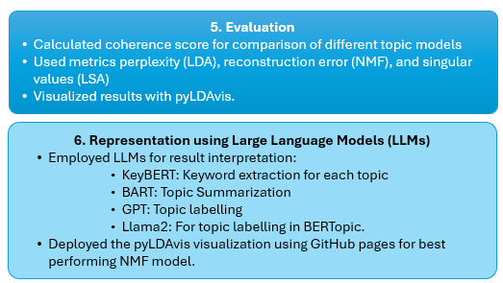
Methodology

Slide 11
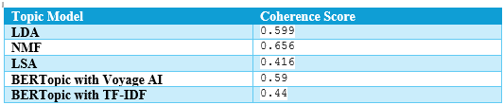
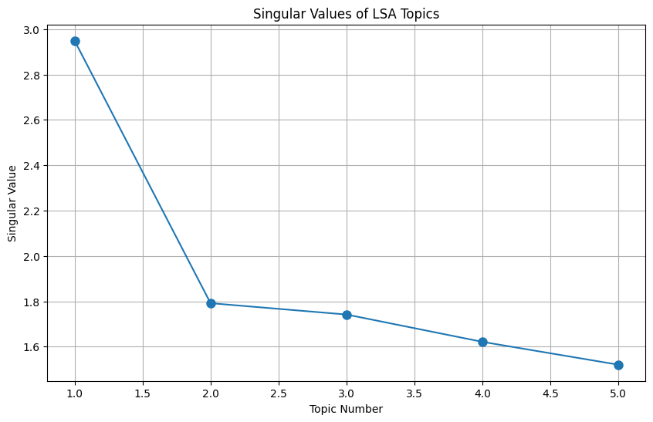
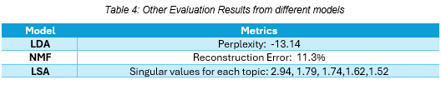
Results
We identified five topics related to social support. Among these, emotional support is the most predominant in the text.
Model comparisons: NMF performed best, achieving the highest coherence score of 0.656.
Table 1: The Coherence Scores for different Topic models used
Table 2: Other Evaluation Results from different models

Slide 12
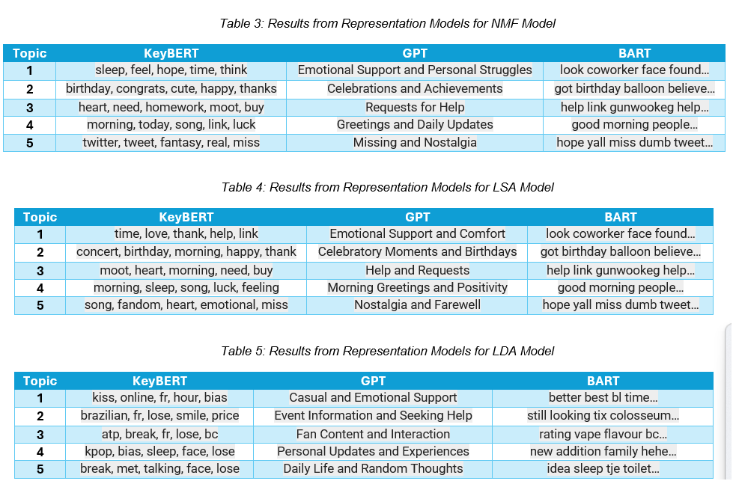
Results

Slide 13
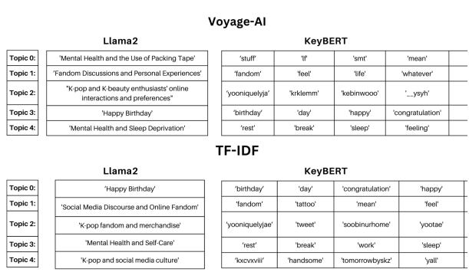
Results (From Representation models)
BERTopic
Voyage AI:
TF-IDF:

Slide 14
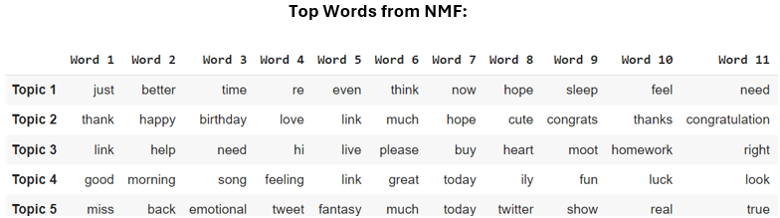
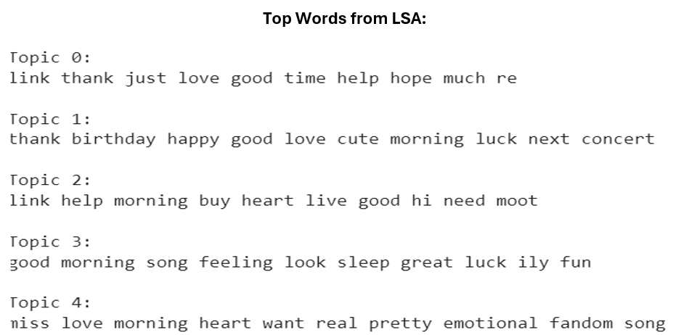
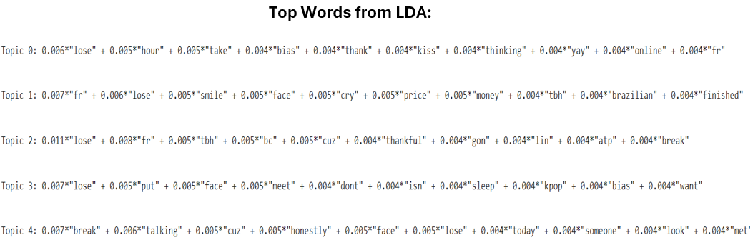
Results
Top Words from Different Models

Slide 15
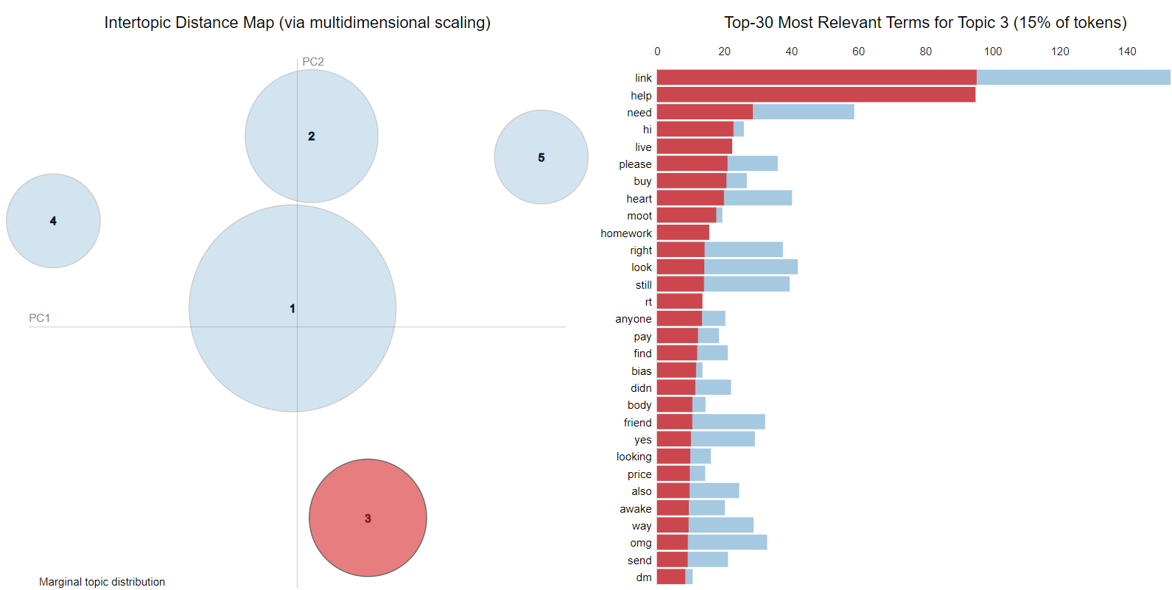
Results
Topic 3: Requests for help
Code: https://colab.research.google.com/drive/1i-hdc9CkKfKcLECtmv93rHjU0ug8_epW?usp=sharing
Fig. 2 pyLDAVis Visualization for NMF model

Slide 16
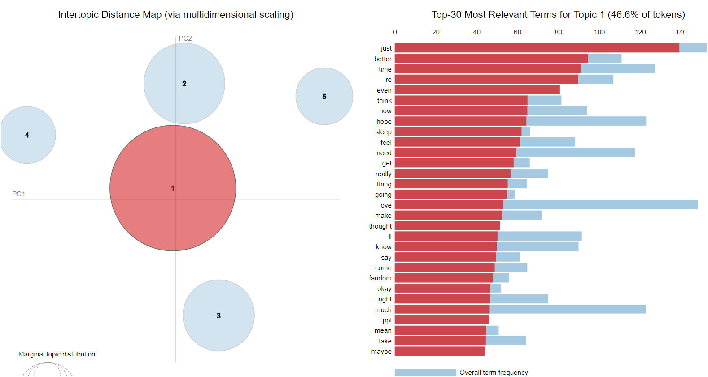
Results
Topic 1:Emotional Support and Personal Struggles
Deployed link:
https://aditisatsangi.github.io/Globalizing-K-Pop-Project-Analysing-Social-Support-using-Topic-Modelling-and-LLMs/#topic=0&lambda=1&term=
Fig. 2 pyLDAVis Visualization for NMF model

Slide 17
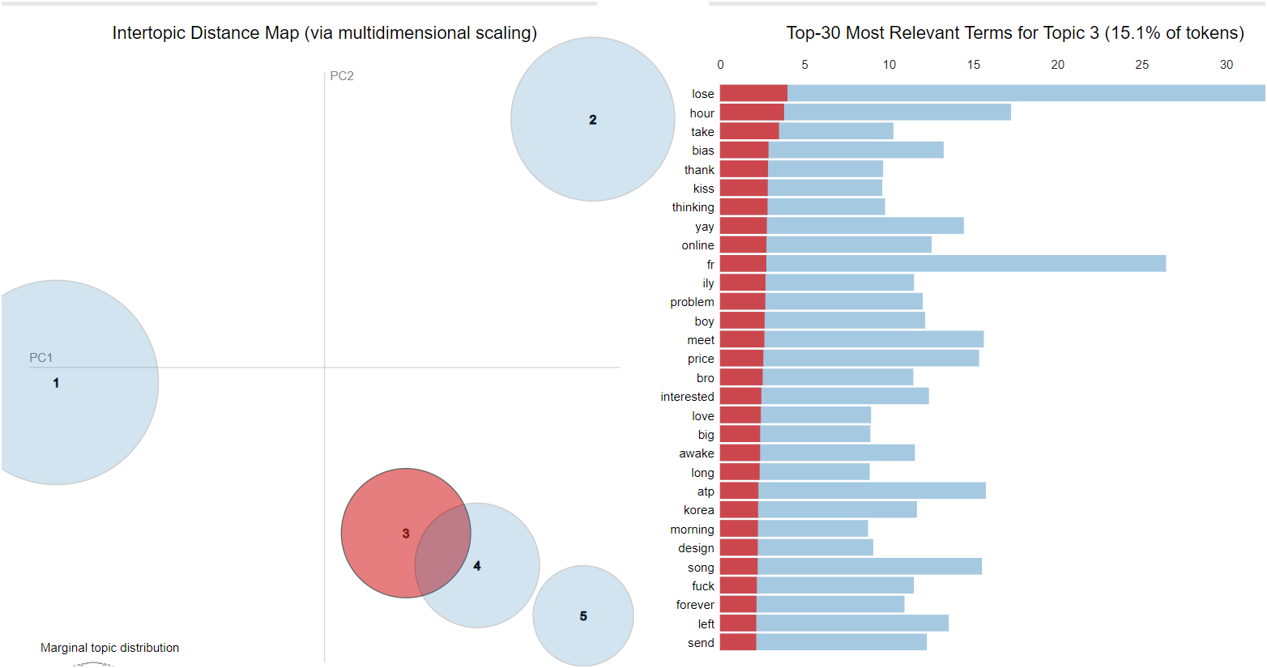
Results
Topic 3: Fan Content and Interactions
Fig. 3 pyLDAVis Visualization for LDA model

Slide 18
Results
Top Documents from Best Performing Model NMF:
Topic 1: Emotional Support and Personal Struggles:
Post1 : it's been a really rough day for me mentally so i just want to thank all of you who gave me birthday wishes today. i think i would go crazy without you guys. all i can do is hope tomorrow is better. i love you guys....
Responses:
Response 1: -@jaengpup i love u and i hope things get better for you soon https://t.co/LQMzBNUr6b...
Response 2: - @jaengpup no problem &lt;3 https://t.co/mkWOjkTtPd...
Response 3: - @ayseetemasu my ayse thank u for always being kind to me...
Response 4: - @bearyuns i love u too bee :(...
Response 5: - @oxshyuk thank you so much eli :( this is really sweet...
Response 6: - @jaengpup we love you pup! tomorrow is going to be better and we will ALL always be behind you 100% ! be kind to yourself you deserve it...
Response 7: - @jaengpup we love you too pup 💗...
Response 8: - @jaengpup love u more than u know my jaspie 🩷 https://t.co/Hz8ctY1bOh

Slide 19
Results
Top Documents from Best Performing Model NMF:
Topic 2: Celebrations and Achievements :
Post : down and disheartened by things today, but i made it to 24. (i’m also spending it at work rip) i’m still on my break, but i wanted to check in. hope everyone is well. i’ll be back with a new fic this month as a gift to you all. i hope u enjoy it. &lt;3 be back soon ( ´ ω ` )ノ https://t.co/ba6JNDP9Up
Responses:
Response 1 - @sonderstarlight Happy Happy … enjoy https://t.co/fTtkyznHVZ...
Response 2- @sonderstarlight Happy birthday Siren!! 🩵💙🎉 Sending best wishes your way, may this year bring you many moments of love and happiness. Treat yourself, you deserve it- take care https://t.co/O4atCzDBfc...
Response 3- @sonderstarlight happy birthday!!...1328578923580502016- @sonderstarlight Happy happy day to you 💛💛💛💛💛💛💛💛...1
Response 4- @sonderstarlight happy bday bb!!! hope you feel better soon and get lots of hugs and rest. stay hydrated!...
Response 5- @sonderstarlight HAPPY BALLOONY DAY SIREN!!!! 😍🥰🥰🥳🥳🥳🪷🪷🪷🪷🪷🪷🪷🪷🪷 Please take some rest and enjoy your favourites if you can!...
Response 6- @sonderstarlight happy birthday! 🎉 I know birthdays can be rough sometimes, but I hope there are some moments you can enjoy!...
Response 7- @sonderstarlight happy birthday💕! i wish you lots of happiness and i hope you enjoy your day! 🩵...

Slide 20
Results
Top Documents from Best Performing Model NMF:
Topic 3: Requests for Help:
Post : HELP I AM NOT OKAY OMG https://t.co/n3KW0UTznp...
Responses:
Response 1 - @Lillinn333 Best way to start your day 🤩...
Response 2- @kxcvxvii I woke up to so much hotness 🫠🫠 I’m melting...
Response 3- @kxcvxvii 😅😅😅😂😂😂😂😂 I think youngbin shocked a lot of his wife tonight....
Response 4- @keyz1206 He needs to make me come back to life with a kiss🤭🤭🤭🤭...
Response 5- @kxcvxvii 😅😅😅😅😂😂😂😂 I will tell him in the fancafe that he gave you a heart attack 😂😂😂...
Response 6- @keyz1206 YES KEYZ HELP OUR HUSBAND IS KILLING ME https://t.co/cY4RKrVxM4...
Response 7- @kxcvxvii do you need an ambulance...
Response 8- @kxcvxvii 🔥Hottie🫠🤤 https://t.co/yefxyy9uCL

Slide 21
Results
Top Documents from Best Performing Model NMF:
Topic 3: Requests for Help:
Post : Still looking for 1 Tix Johnny Be Colosseum for my friend because her ticket got cancelled. She's a johfam so please help her to meet Johnny 🥺 wtb johnny be colosseum #JOHNNYbeAtColosseumJKT...
Responses:
Response 1 - @Midsummer_JY Hey why not message (Zaharaleonhard_) on Instagram she's still selling her ticket's...
Response 2 - @Midsummer_JY Hiii Message (_mary.roland_) on instagram, she’s selling her tickets if you’re still interested...
Response 3 - @Midsummer_JY MesAge me please can show proof of purchase and willing too sale for face value or less than face value...
Response 4- @Midsummer_JY Dm me, I’m looking to sell

Slide 22
Results
Top Documents from Best Performing Model NMF:
Topic 4: Greetings and Daily Updates :
Post : good morning people in my phone ily https://t.co/n0hm2NtCc4
Responses:
Response 1 - @dahlihwa good morning 😁...
Response 2- @dahlihwa Good morning em♡
Topic 5: Missing and Nostalgia :
Post : i hope yall miss me and my dumb tweets...
Responses:
Response 1 - @merlotmv dont worry im back again (until the next concert)...
Response 2 - @haonslut i will miss u sm :(...
Response 3- @95MINSIK ill be back...
Response 4- @emmys_archive so true...
Response 5- @justerithings true same...
Response 6- @haonslut yes i miss you and your tweets...
Response 7- @haonslut i will miss you today tomorrow and forever...
Response 8- @haonslut I always miss us...
Response 9- @tyyunseo im gonna be back soon

Slide 23
Future Work
We can apply pre-trained models (Transfer Learning) to enhance performance.
We can validate the dataset by manually labeling a small subset to ensure accuracy and quality.
We can apply the Generative adversarial Networks (GANs) for increasing the size of the dataset.

Slide 24
Conclusion
Best Performing Model: The Non-Negative Matrix Factorization (NMF) topic model emerged as the best performing model with a coherence score of 0.656.
Social Support in K-Pop Communities: Our analysis of Twitter conversations reveals clear evidence of social support within K-Pop online communities. The NMF model, particularly through the pyLDAvis visualization, highlights that emotional support is the most prominent, accounting for 46.6% of the tokens.
Consistency Across Models: All four topic models consistently identified themes related to social support.
Emotional support was most commonly associated with discussions about personal struggles.
Appraisal support was found in opinion-sharing and achievement-related conversations.
Informational support appeared in academic-related discussions and during merchandise purchases.
Instrumental support was evident in conversations about the purchasing process and events.
Comprehensive Support Identification: Through the combination of topic modeling and large language models, we successfully identified all forms of social support within the analyzed text. However, we were unable to identify social emotional support in the Reddit data as effectively as we did in the Twitter data.

Slide 25
References
[1] Egger, Roman, and Joanne Yu. "A topic modeling comparison between lda, nmf, top2vec, and bertopic to demystify twitter posts." Frontiers in sociology 7 (2022).
[2] Zhao, Siqi. "Latent Dirichlet Allocation (LDA)." Towards Data Science, Medium, 24 Jan. 2018, towardsdatascience.com/latent-dirichlet-allocation-lda-9d1cd064ffa2. Accessed 12 Aug. 2024.
[3] Prasad, Jay. "What Is Non-Negative Matrix Factorization (NMF)?" Codex, Medium, 8 July 2020,medium.com/codex/what-is-non-negative-matrix-factorization-nmf-32663fb4d65. Accessed 12 Aug. 2024.
[4] "Latent Semantic Analysis." Wikipedia, The Free Encyclopedia, 12 Aug. 2024, en.wikipedia.org/wiki/Latent_semantic_analysis. Accessed 12 Aug. 2024.
[5] Grootendorst, Maarten. "BERTopic: Neural Topic Modeling with a Class-Based TF-IDF Procedure." arXiv preprint arXiv:2203.05794, 2022, https://arxiv.org/abs/2203.05794.
[6] Deployed Site link(visualization) for best performing NMF model:
https://aditisatsangi.github.io/Globalizing-K-Pop-Project-Analysing-Social-Support-using-Topic-Modelling-and-LLMs/#topic=0&lambda=1&term=

Slide 26
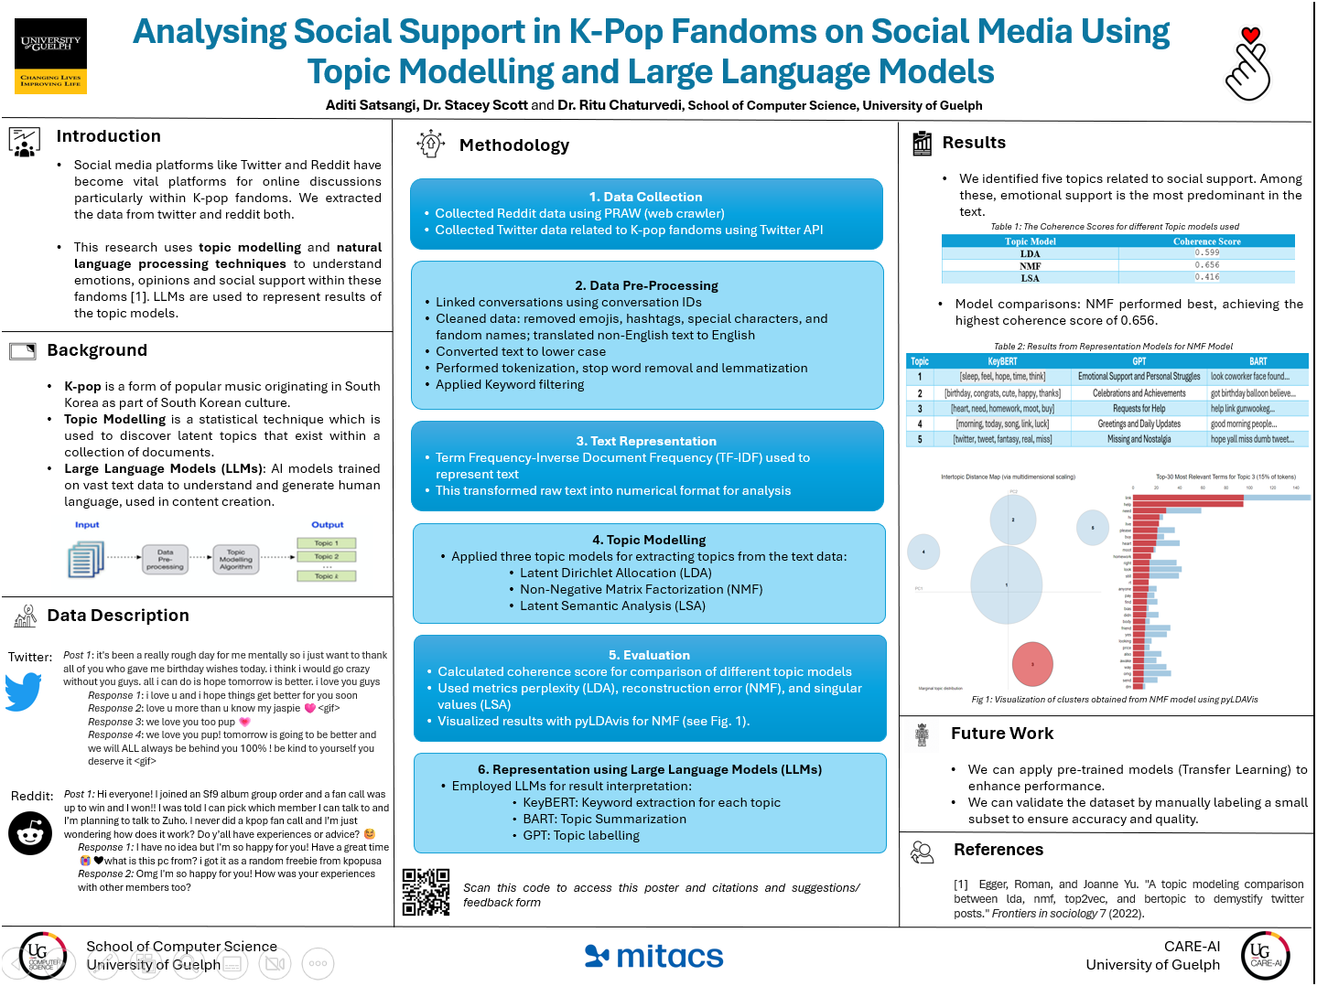
Thank You
Poster

